Slide 1

TRADE GUIDE
L’EARN TO TRADE.
THROUGH TRADE.
TEAM MEMBER: -
B SRI KANISHKA REDDY (1602-19-737-111)
JOSHUA PETER (1602-19-737-075)
SRICHARAN (1602-19-737-112)

Slide 2
ABSTRACT
The nature of stock market movement has always been ambiguous for investors because of various influential factors.
So, without a proper knowledge about the crypto - money is significantly at a high risk.
Here at trading guide we aim to help educate the world on the ever-growing crypto currency market. And to help them become confident and successful trader.
From understanding how crypto works to learning how to invest into it.
It helps to know how actual value of a particular crypto coin has been changing according to trends in the market .

Slide 3
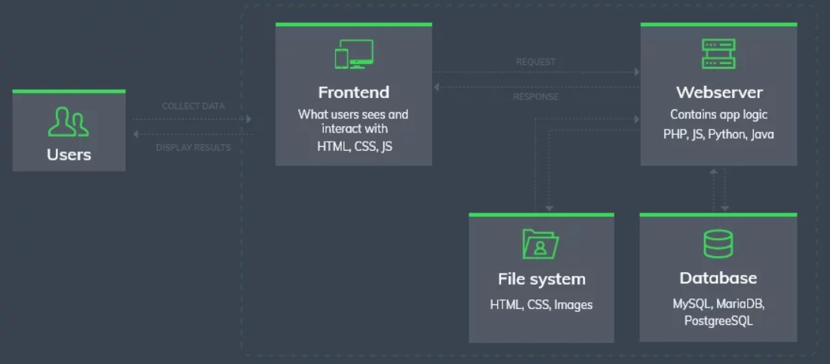
ARCHITECTURE: -

Slide 4
SYSTEM REQUIREMENTS
Software Requirements:
INTERPRETER:
Visual Studio Code
Text Editor
Architecture and Technology:
Use Front-End:
1) HTML
2) CSS
3) JAVA SCRIPT
4) BOOTSTRAP
Back-End:
1) MySQL (Xampp)

Slide 5
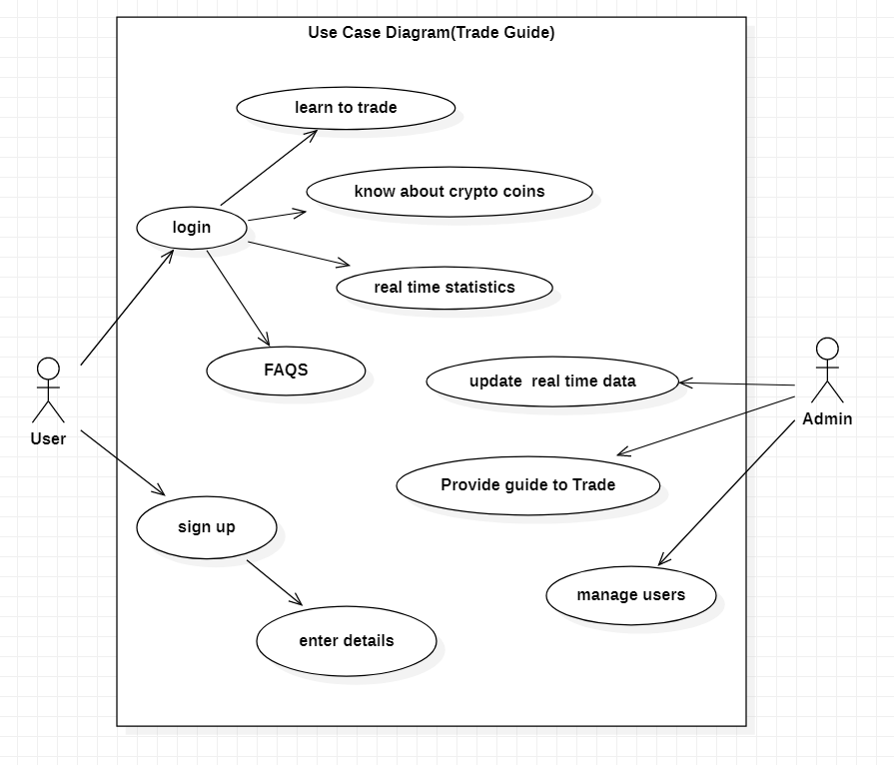
USE CASE :

Slide 6
Design of our web page: -
Login/Register page
Home page
How to Trade(providing guidance to the user)
Know different crypto coins and their importance
Statistics – to analyze the market trends
FAQS

Slide 7
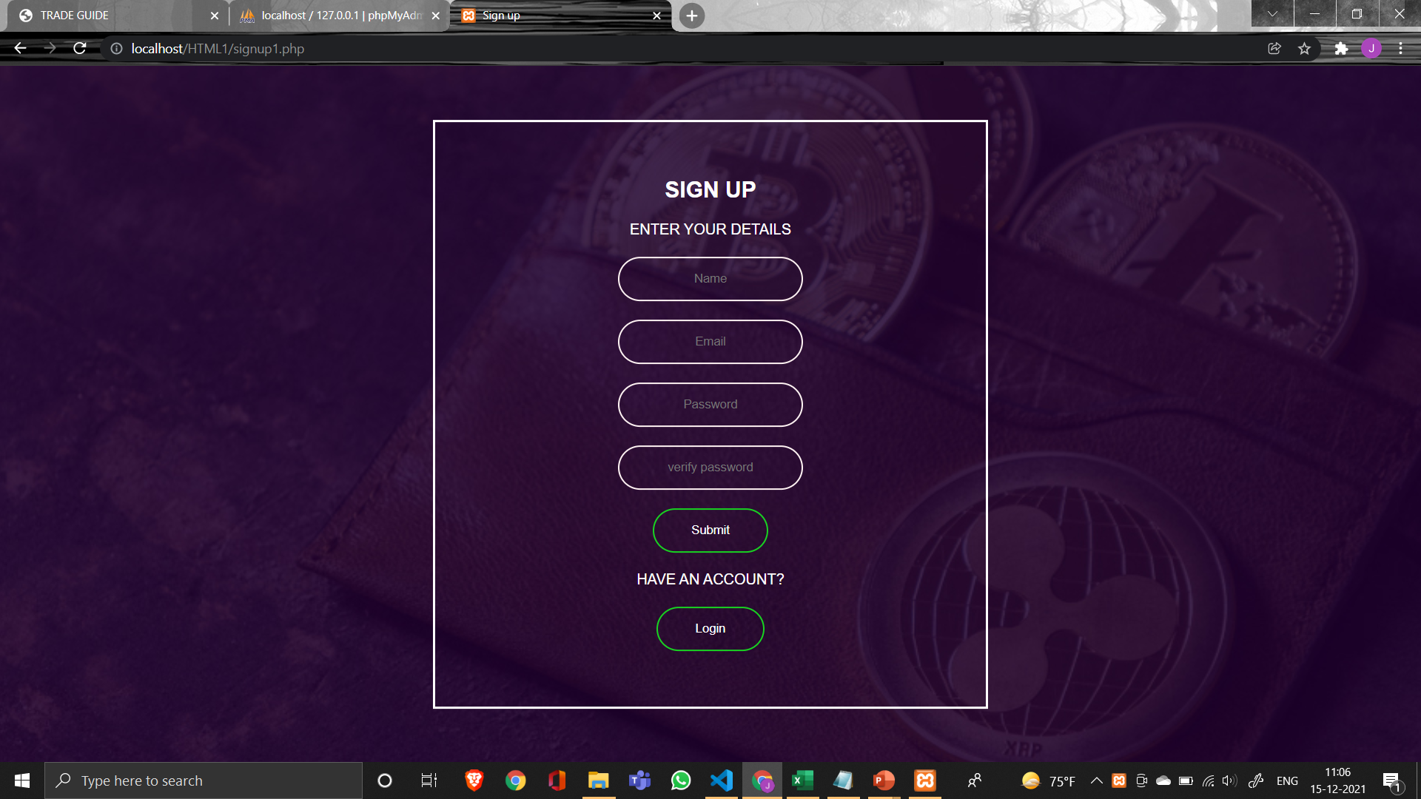
SIGNUP PAGE :

Slide 8
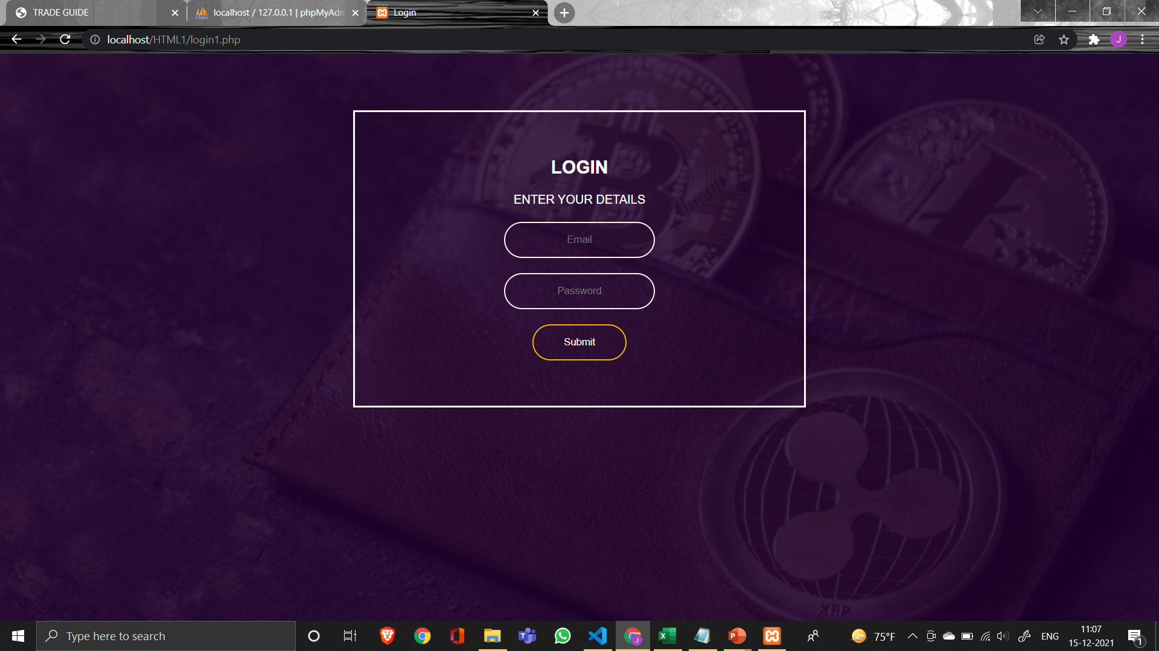
LOGIN PAGE :

Slide 9
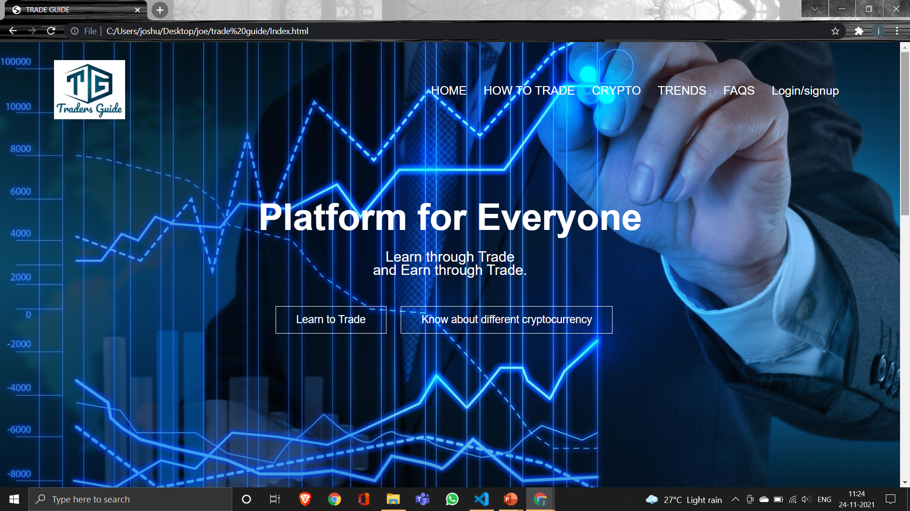
HOME PAGE :

Slide 10
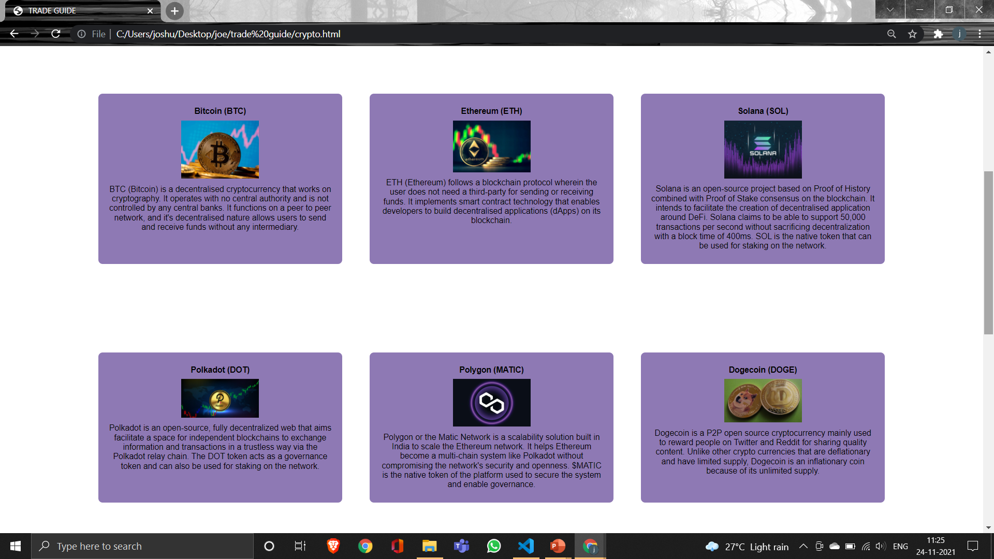
DIFFERENT CRYPTOCURRENCY PAGE :

Slide 11

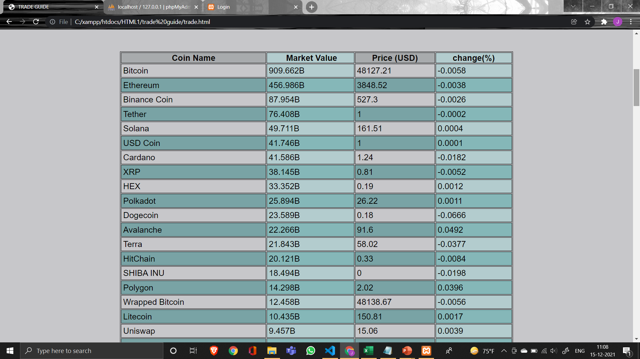
CRYPTOCURRENCY PRICES :

Slide 12
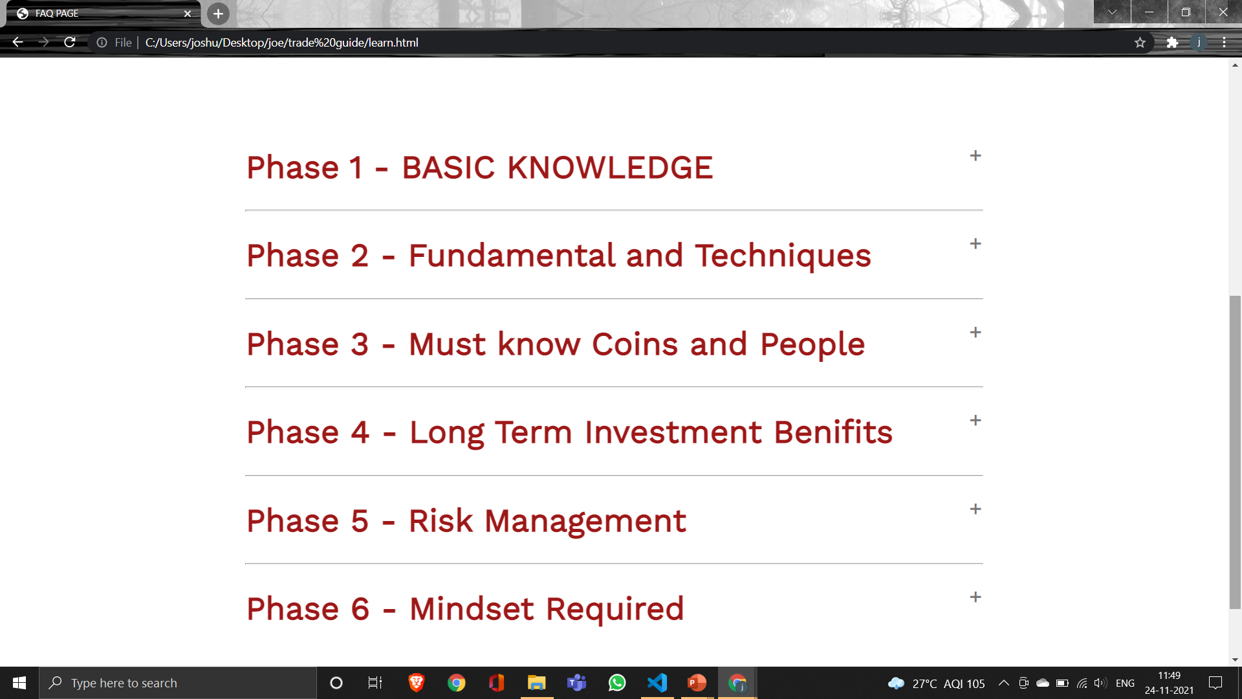
How to Trade PAGE :

Slide 13
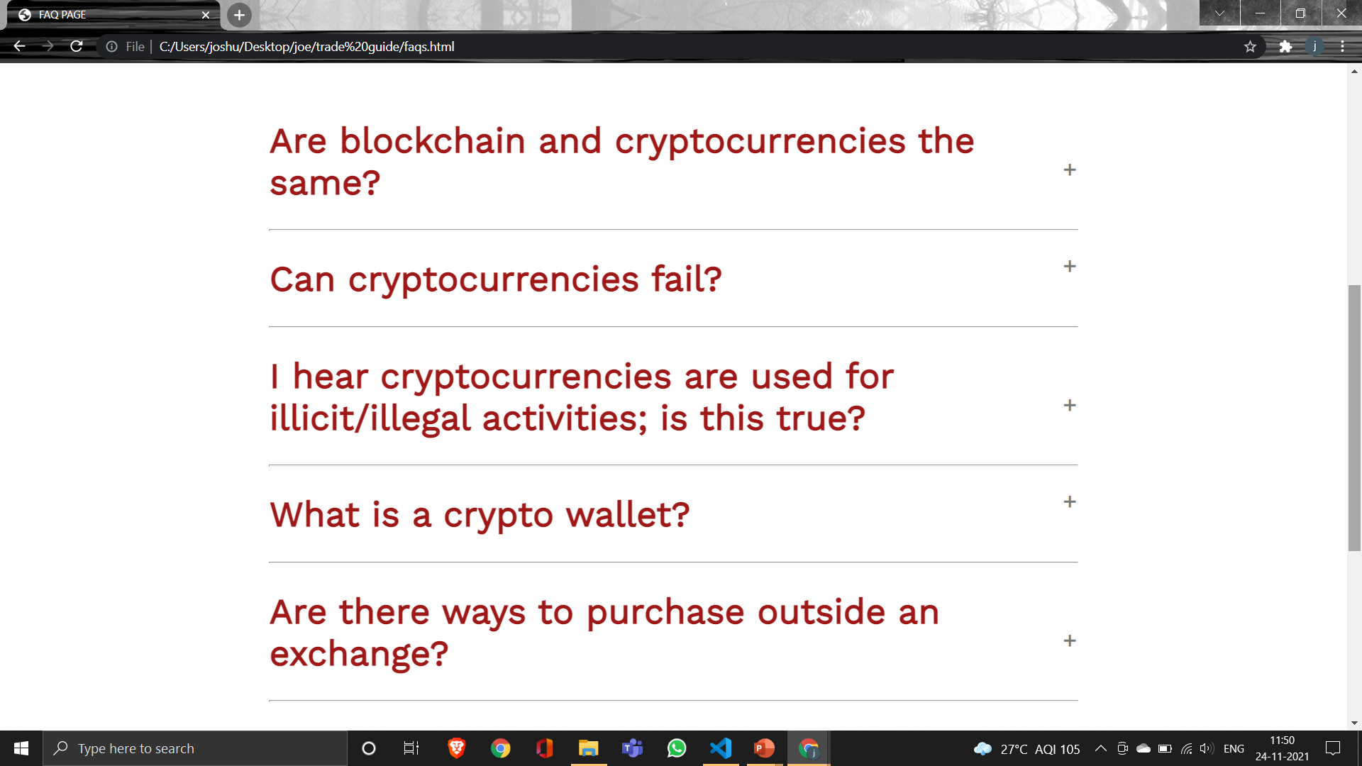
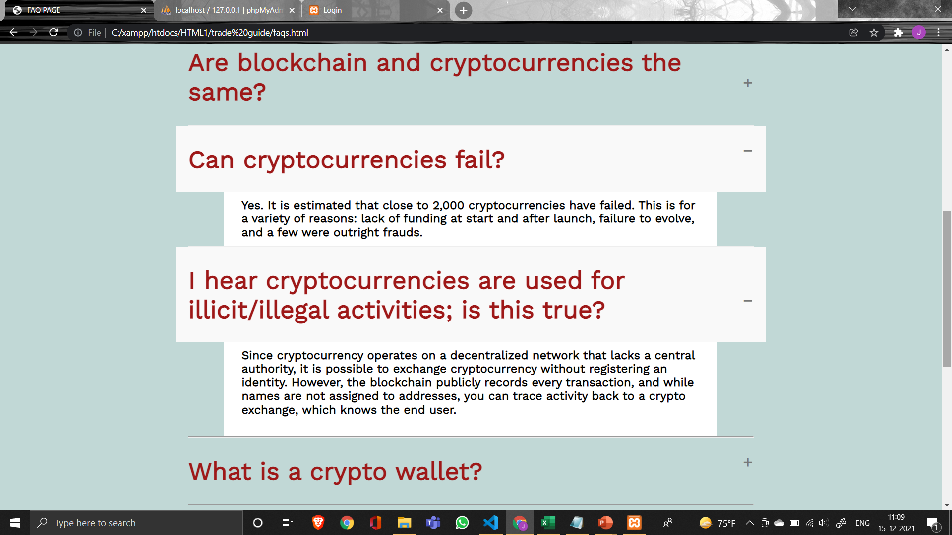
FAQS PAGE :

Slide 14
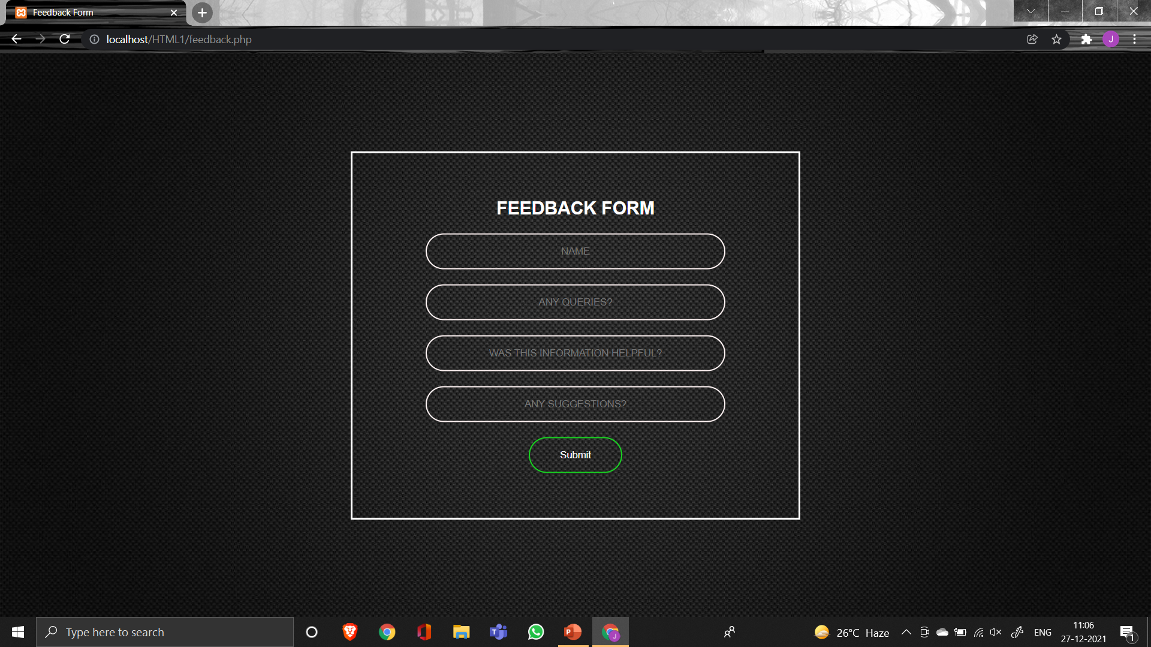
FEEDBACK PAGE :

Slide 15
REFERENCES
https://www.geeksforgeeks.org/
https://www.tutorialspoint.com/index.htm
https://getbootstrap.com/
https://www.w3schools.com/

